Slide 1




Level Up Learning: Revolutionizing Education with Innovative EdTech Tools
In an era marked by rapid digital transformation, educational technology (EdTech) has emerged as a powerful force in reshaping the landscape of learning. As we strive to make quality education more accessible, engaging, and personalized for learners worldwide, the development of innovative EdTech tools has become paramount. This visionary project, "Level Up Learning," aims to harness the potential of cutting-edge technologies to create transformative educational experiences that empower students, support teachers, and foster a more inclusive and equitable learning environment.
Gk
by George klaus

Slide 2
Addressing the Challenges in Education
Limited Access to Quality Education
Engagement and Motivation
Personalized Learning
Every student is unique, with their own learning styles, paces, and preferences. Yet, the current educational landscape often falls short in providing personalized learning experiences that cater to individual needs. Bridging this gap is crucial for maximizing student success.
Many students, particularly those in remote and underprivileged areas, face significant barriers in accessing high-quality educational resources and opportunities. This disparity exacerbates educational inequalities and limits the potential of countless learners worldwide.
Traditional teaching methods often fail to capture and sustain students' attention and interest, leading to disengagement and suboptimal learning outcomes. Innovative approaches are needed to reignite the passion for learning and foster a more dynamic and interactive educational experience.

Slide 3

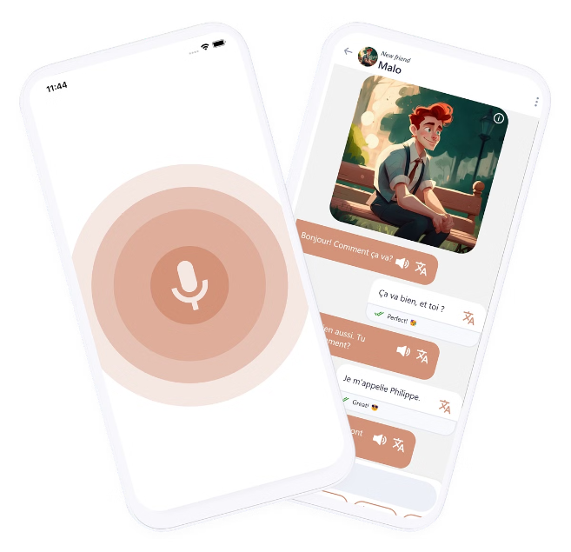
Introducing the Innovative EdTech Solution
1
Interactive Learning Apps
Captivating, gamified learning experiences that enhance student engagement and motivation, making education more enjoyable and effective.
2
AI-Powered Tutoring
Cutting-edge artificial intelligence algorithms that provide personalized tutoring, adapting to each student's unique learning pace and style.
3
Virtual Classrooms
Immersive, real-time collaborative learning environments that replicate the interactivity and participation of physical classrooms, fostering engaged learning.

Slide 4

Empowering Students Through Educational Games
Reinforcing Concepts
Fostering Creativity
Subject-specific educational games that seamlessly integrate learning objectives with engaging gameplay, enhancing knowledge retention and deeper understanding.
Game-based learning environments that encourage creativity, critical thinking, and problem-solving skills, preparing students for the challenges of the 21st century.
Inclusive Design
Adaptive Experiences
Thoughtfully designed games that cater to diverse learners, including those with special needs, ensuring equitable access to educational resources.
Games that dynamically adjust difficulty and content based on individual performance, providing a personalized and engaging learning journey.

Slide 5


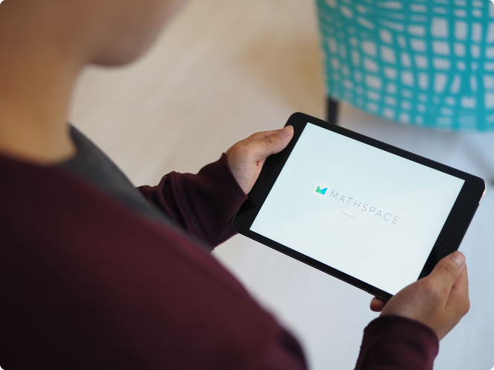



Tailoring the Learning Experience
Student-Centric
The platform places the learner at the heart of the experience, ensuring that each student's unique needs, preferences, and learning styles are catered to.
Empowering Educators
Teachers are equipped with powerful tools and insights to better understand their students' progress, identify areas for improvement, and provide targeted support.
Inclusive Approach
The platform fosters a collaborative learning environment, engaging parents and caregivers to support students' educational journey and promote a holistic approach to learning.
Accessible for All
Comprehensive accessibility features ensure that students with diverse needs, including those with physical, cognitive, or sensory disabilities, can fully participate and thrive in the learning experience.

Slide 6


Driving Positive Impact through Collaboration
1
Empowering Educators
Equipping teachers with the tools and resources they need to create engaging, personalized, and inclusive learning experiences for their students.
2
Fostering Accessibility
Ensuring that quality education becomes truly accessible to learners in remote and underserved communities, bridging the digital divide.
3
Promoting Equity
Addressing educational disparities and creating a more inclusive learning environment that caters to the diverse needs of all students.
4
Unlocking Potential
Unleashing the full potential of learners by providing them with the support, resources, and opportunities they need to thrive.

Slide 7





Achieving Transformative Results
Improved Learning Outcomes
By making education more engaging, personalized, and accessible, the platform aims to boost student performance, knowledge retention, and overall academic achievement.
Increased Equity and Inclusion
The platform's focus on inclusive design and accessibility features will ensure that learners of all backgrounds and abilities have equal opportunities to succeed.
Enhanced Educator Effectiveness
Empowering teachers with powerful tools and data-driven insights will enable them to better support their students' individual needs and foster a more nurturing learning environment.

Slide 8


Shaping the Future of Education
Transformative Impact
By redefining the educational landscape through innovative EdTech solutions, we have the power to unlock the full potential of learners, foster a more equitable and inclusive learning environment, and prepare students for the challenges of the 21st century.
Collaborative Approach
At the heart of this project lies a collaborative spirit, where educators, technologists, policymakers, and community stakeholders work in tandem to create a brighter future for education.
Scalable and Sustainable
The platform is designed to be scalable and sustainable, ensuring that its benefits can be widely accessible and continuously improved upon, driving lasting change in the education sector.

Slide 9
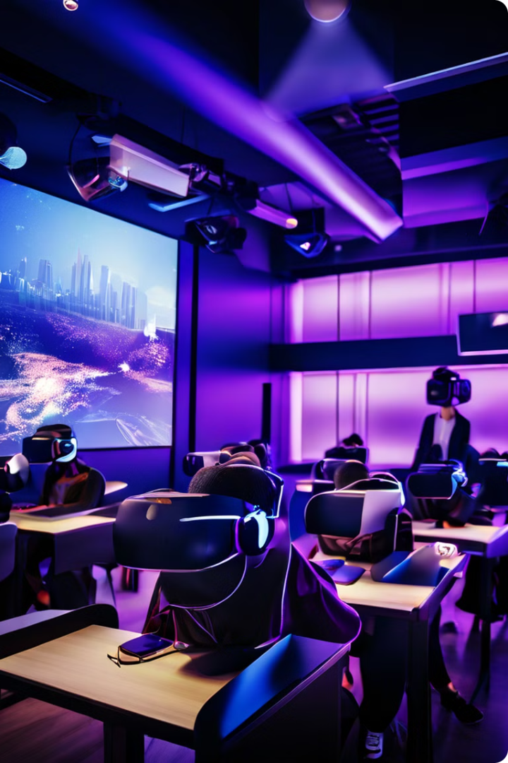
Conclusion
As we have seen, innovative EdTech solutions hold the key to transforming education and unlocking the full potential of learners. Through our collaborative efforts, we are shaping a brighter future where quality education is accessible to all.

Slide 10
Contact Information
Email
1
georgerubinga@gmail.com
2
Phone
+254 725 717 270
Let's Connect
3
Feel free to reach out via email or phone to discuss our innovative EdTech solutions and how we can collaborate to transform education.

